Slide 1

Exploring CRM data to strengthen customer relationships
and tailor strategies.
Navigating Customer
Retention for Long-
Term Success
"In the dynamic landscape of customer relationships, our journey begins
with the pursuit of long-term success through effective retention
strategies. Join us as we delve deep into targeted retention initiatives,
gender-specific campaigns, and engaging younger audiences to chart the
course to sustained growth and customer loyalty."

Slide 2

Targeted Retention Programs
Objective: "Our primary aim is to reduce churn and strengthen connections with our esteemed
AgeBucket 50+ customers through personalized retention programs and incentives, elevating their
satisfaction and loyalty."
Personalized
Programs
Elevated
Satisfaction
Deepening
Connections
Designing tailored
Anticipating a notable rise
in loyalty and contentment
among the valued
Strengthening the
relationships with
programs that resonate
specifically with the
AgeBucket 50+ customers
through proactive and
personalized retention
strategies, leading to
robust, enduring
preferences and needs of
the AgeBucket 50+
AgeBucket 50+ age group
due to the implementation
of these targeted and
demographic, fostering a
deeper connection and
enhancing satisfaction.
personalized initiatives.
connections.

Slide 3

Personalized Retention Solutions:
Sculpting Enduring Connections
1
Tailoring
2
Communication
3
Empathy and Excellence
Incentives
Customizing
Fostering deep-rooted
connections through
personalized incentives.
communication to
individual customer needs.
Commitment to
understanding, empathy,
and customer-centric
excellence.

Slide 4

Understanding Customer Dynamics:
Insights and Strategies
1
2
3
Mapping Customer Journeys
Focusing on retention across varied segments and unraveling churn drivers.
Leveraging Insights
Crafting targeted strategies to stem attrition effectively.
Forging Pathways
Navigating diverse terrains of customer relationships for sustained growth.

Slide 5

The Challenge: Cracking the Churn
Code
Problem Statement: "Our challenge revolves around understanding and reducing churn rates across diverse customer segments. Upon analyzing the data, we've identified a higher churn rate among the AgeBucket 50+ customer segment, signifying a significant area where improvements are essential."
1
2
Understanding Churn Dynamics
Analyzing the churn trends and identifying the contributing factors across various customer segments to unravel the underlying dynamics.
Data-Driven Insights
Utilizing advanced analytics platforms to gain detailed insights into the reasons behind churn, and to identify patterns that could aid in formulating targeted strategies.
3
Implementing Improvement Measures
Developing and implementing corrective strategies aimed at minimizing the churn rates, especially within the AgeBucket 50+ segment.

Slide 6
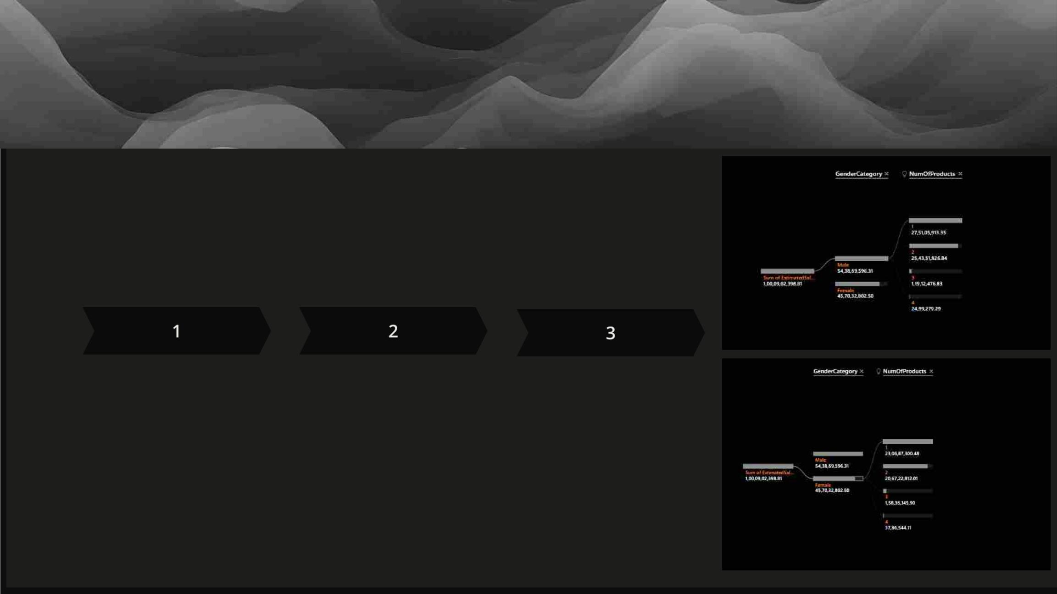
Unveiling Gender Insights
Objective: "We aim to decipher the nuances of gender-specific churn, creating campaigns tailored to address the distinct challenges faced by our female clientele, ultimately fostering unwavering loyalty and satisfaction."
Understanding
Female Churn
Dynamics
Personalized
Communication
Fostering Loyalty
Anticipating a significant
transformation in retention rates and satisfaction levels among our female customer base due to personalized and effective
Crafting personalized
Delving into the unique reasons behind female churn through a
communication approaches to resonate with the specific needs and preferences of our female customers, enhancing their loyalty and contentment.
comprehensive analysis aimed at developing
communication.
targeted retention strategies.

Slide 7
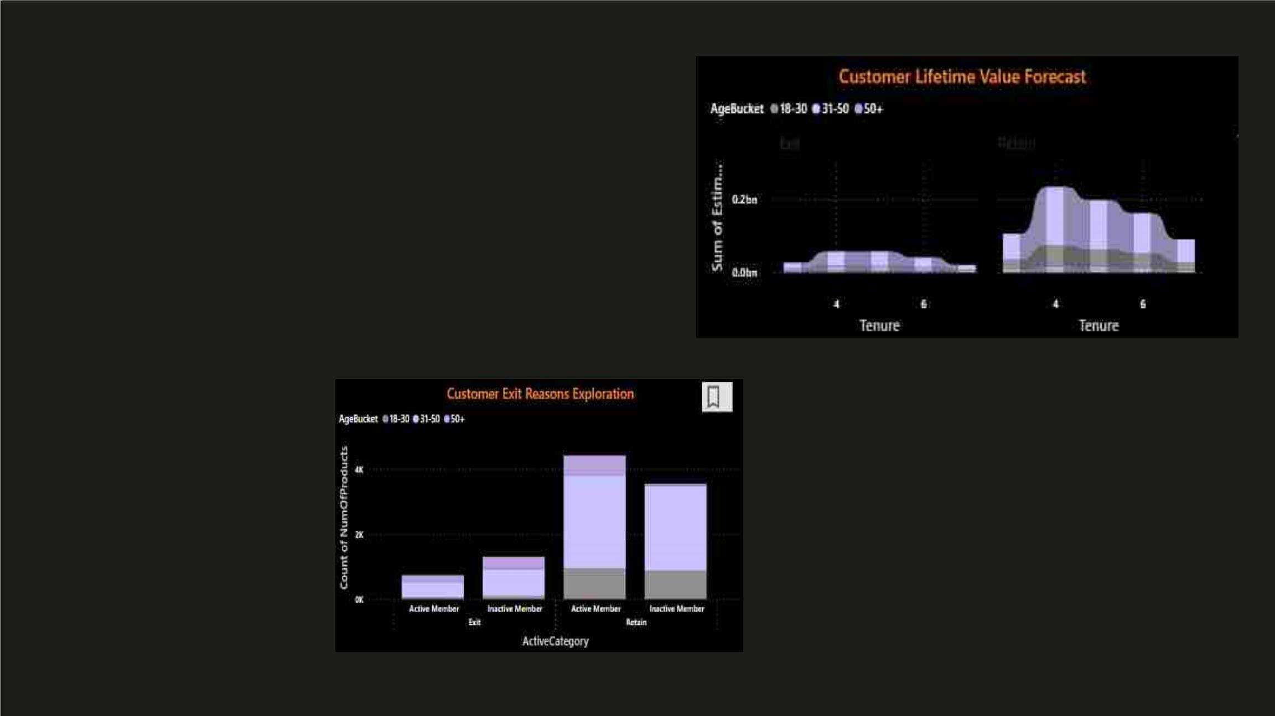
Captivating the Next
Generation
Objective: "Embarking on a mission to elevate the banking
experience for the dynamic 18-30 age group through strategic
initiatives customized to their preferences, envisioning stronger
loyalty and reduced churn rates."
18-30
Engagement
Strategic Initiatives
Enhanced Engagement
Developing exclusive offers,
innovative digital features, and
educational resources tailored to the
unique needs of the younger
generation.
Envisioning robust engagement and a consequent
decline in churn rates among the dynamic 18-30 age
group through our strategic initiatives.

Slide 8
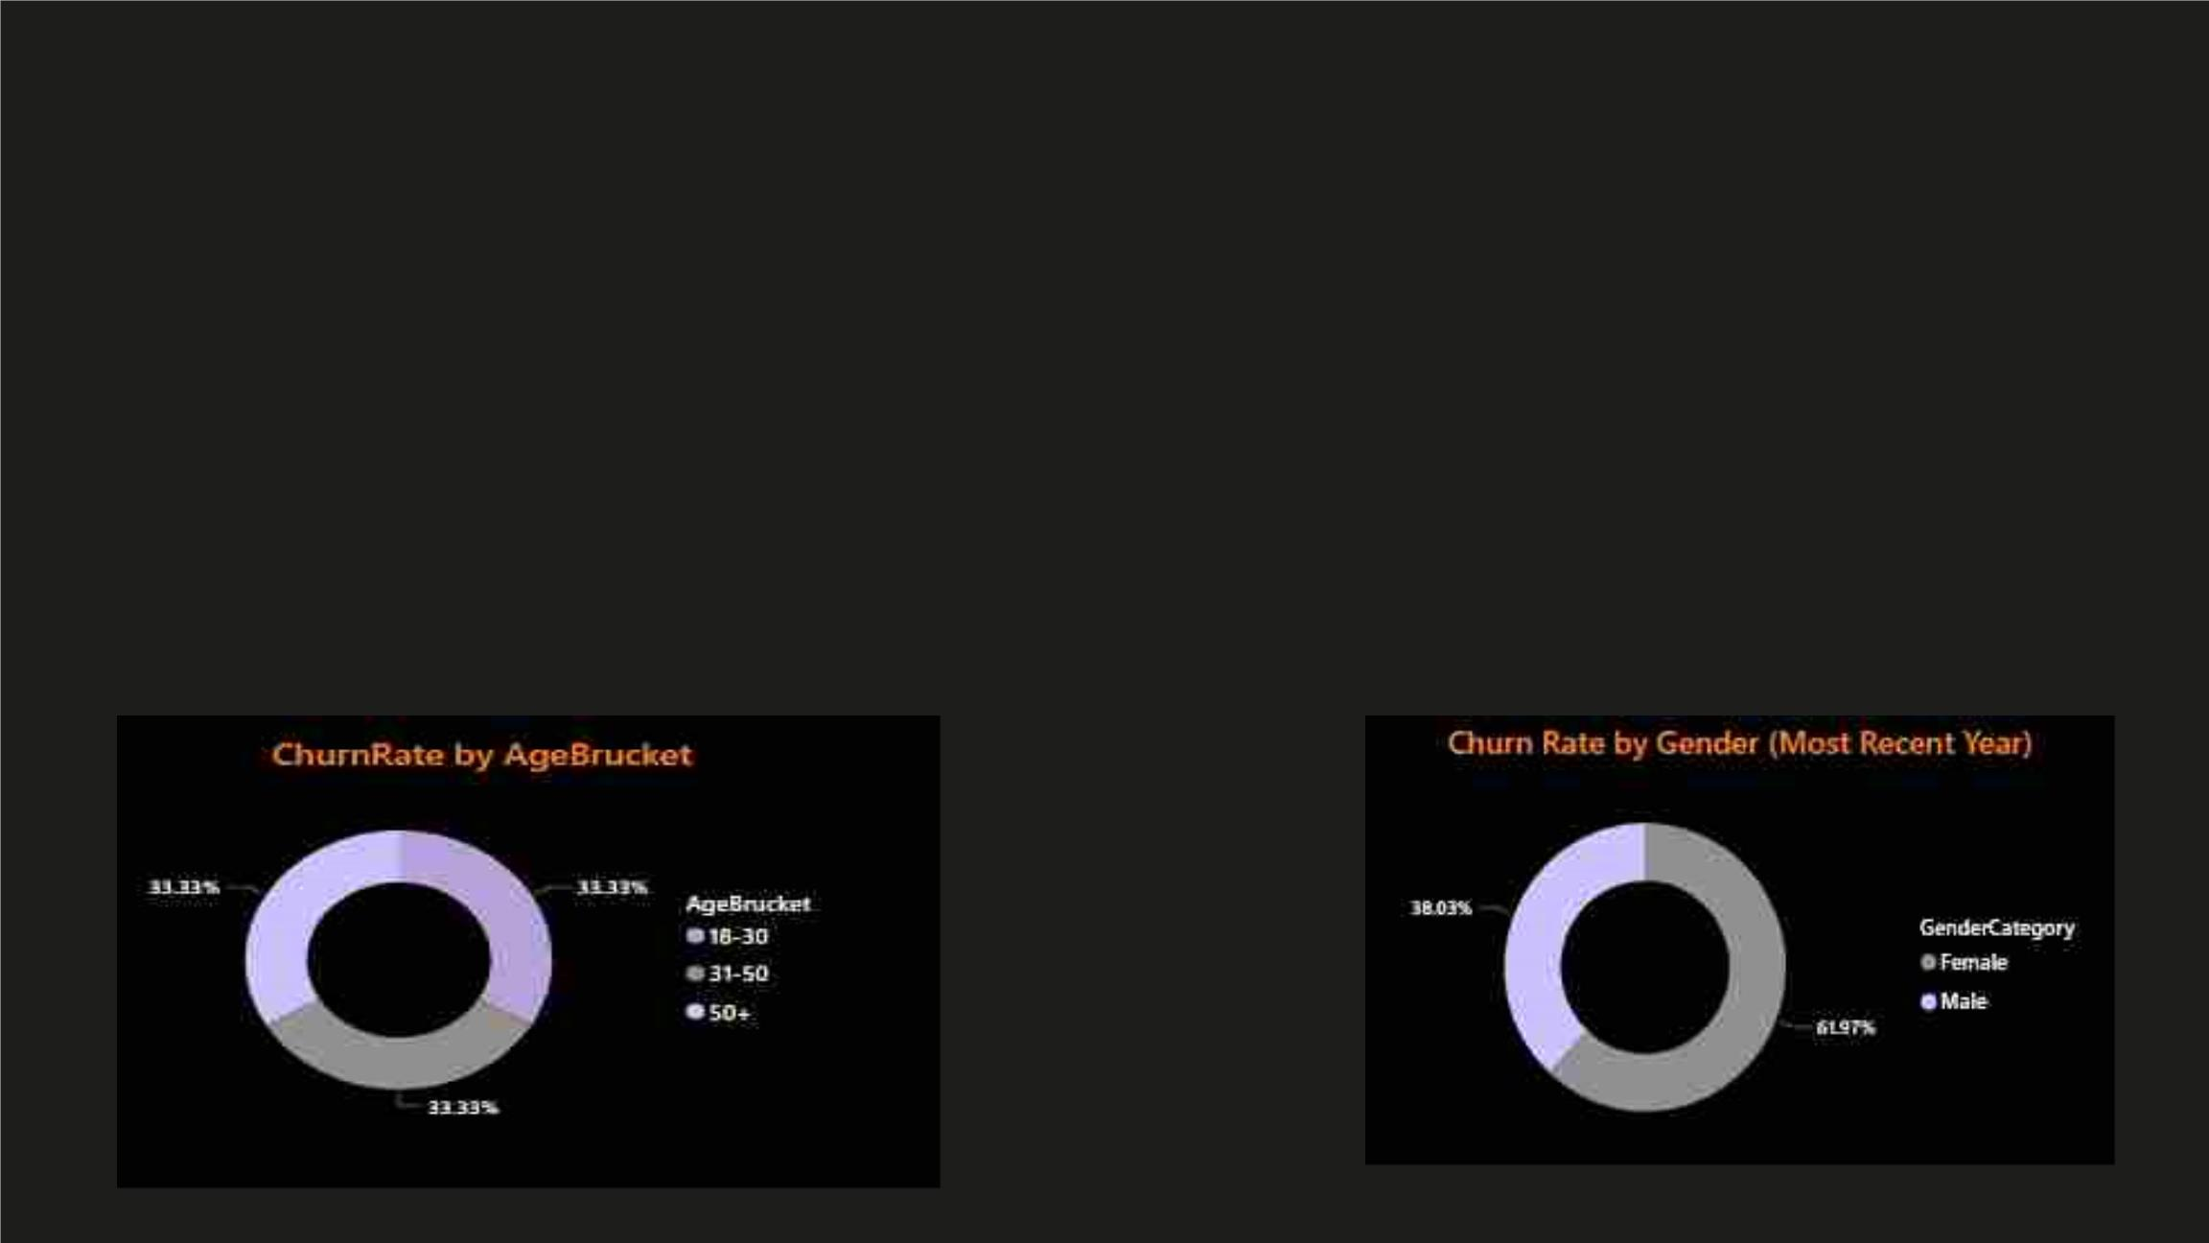
The Tapestry of Insights
Objective: "Weaving together insights from age-wise and gender-based churn analyses to create a comprehensive tapestry of understanding, spotting behavioral patterns guiding strategic decisions."
Age-Wise Insights
Gender-Based Patterns
Utilizing detailed age-wise churn analyses to
identify patterns and trends, allowing for targeted retention strategies and initiatives.
Spotting unique patterns in gender-based churn that aid in crafting personalized approaches for enhancing customer satisfaction and loyalty.

Slide 9

Crafting CRM Solutions
Recommendations: "Deploying personalized incentives and campaigns aimed at addressing the distinct requirements of the AgeBucket 50+ demographic, females, and the dynamic 18-30 age group. Proactive interventions based on continuous monitoring and educational campaigns nurturing long-term relationships."
1
2
3
Personalized Incentives
Designing and deploying incentives tailored to the unique needs and preferences of
different customer segments, fostering a stronger connection and loyalty.
Proactive Interventions
Implementing proactive measures based on continuous monitoring to address churn
across diverse customer segments, nurturing enduring relationships.
Educational Campaigns
Developing educational campaigns aimed at nurturing long-term customer relationships, thereby reinforcing customer satisfaction and loyalty.

Slide 10

Conclusion and Future Horizons
Recap: "Reflecting on targeted strategies, data-driven decisions, and the proactive measures paving the way to long-term success. Anticipate the integration of AI, enhanced data analytics, and a continuous focus on customer feedback for future excellence."
1
Data-Driven Strategies
2
Integration of AI
Utilizing insights from advanced
analytics to drive targeted strategies
and initiatives, enhancing customer
retention and satisfaction.
Embracing AI for enhanced data
analytics and leveraging customer
feedback for continuous
improvement and future excellence.

Slide 11
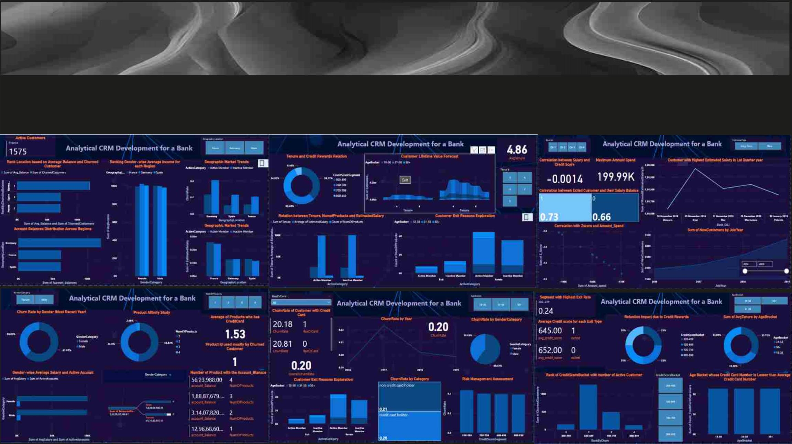
My Report

